Slide 1
Industrial Economics PPT - 11
Monopoly
Notes:
This lecture slide has Additional Notes attached to some slides. Look at the notes section of each slide, so as to not miss to read them.

Slide 2
What is Monopoly…?
Mono = single
poly = seller
An Example:
A personal computer probably uses some version of Windows, the operating system sold by the Microsoft Corporation. When Microsoft first designed Windows many years ago, it applied for and received a copyright from the government. The copyright gives Microsoft the exclusive right to make and sell copies of the Windows operating system. If a person wants to buy a copy of Windows, she has little choice but to give Microsoft the approximately $100 that the firm has decided to charge for its product. Microsoft is said to have a monopoly in the market for Windows.
In competitive markets, many firms offer essentially identical products, so each firm has little influence over the price it receives. By contrast, a monopoly such as Microsoft has no close competitors and, therefore, has the power to influence the market price of its product.
Whereas a competitive firm is a price taker, a monopoly firm is a price maker.
We examine the implications of this market power.

Slide 3
Market Power alters the relationship between a firm’s costs and the price at which it sells its product.
A competitive firm takes the price of its output as given by the market and then chooses the quantity it will supply so that price equals marginal cost. By contrast, a monopoly charges a price that exceeds marginal cost.
Eg: in the case of Microsoft’s Windows. The marginal cost of Windows—the extra cost that Microsoft incurs by printing one more copy of the program onto a CD—is only a few dollars. The market price of Windows is many times its marginal cost.
Monopolies charge high prices for their products. Customers of monopolies might seem to have little choice but to pay whatever the monopoly charges. But if so, why does a copy of Windows not cost $1,000? Or $10,000?
The reason is that if Microsoft were to set the price that high, fewer people would buy the product. People would buy fewer computers, switch to other operating systems, or make illegal copies.
A monopoly firm can control the price of the good it sells, but because a high price reduces the quantity that its customers buy, the monopoly’s profits are not unlimited.

Slide 4
We examine the production and pricing decisions of monopolies, we also consider the implications of monopoly for society as a whole.
In competitive markets, self-interested consumers and producers reach an equilibrium that promotes general economic well-being, as if guided by an invisible hand. By contrast, because monopoly firms are unchecked by competition, the outcome in a market with a monopoly is often not in the best interest of society.
One of the Ten Principles of Economics is that governments can sometimes improve market outcomes.
As we examine the problems that monopolies raise for society, we discuss the various ways in which government policymakers might respond to these problems.

Slide 5
Why Monopolies Arise?
monopoly - a firm that is the sole seller of a product without close substitutes
A firm is a monopoly if it is the sole seller of its product and if its product does not have close substitutes. The fundamental cause of monopoly is barriers to entry: A monopoly remains the only seller in its market because other firms cannot enter the market and compete with it.
Barriers to entry, in turn, have three main sources:
Monopoly resources: A key resource required for production is owned by a single firm.
Government regulation: The government gives a single firm the exclusive right to produce some good or service.
The production process: A single firm can produce output at a lower cost than can a larger number of firms.

Slide 6
Monopoly Resources
The simplest way for a monopoly to arise is for a single firm to own a key resource.
Not surprisingly, the monopolist has much greater market power than any single firm in a competitive market.
A classic example of market power arising from the ownership of a key resource is DeBeers, the South African diamond company. Founded in 1888 by Cecil Rhodes, an English businessman (and benefactor for the Rhodes scholarship), DeBeers has at times controlled up to 80 percent of the production from the world’s diamond mines. Because its market share is less than 100 percent, DeBeers is not exactly a monopoly, but the company has nonetheless exerted substantial influence over the market price of diamonds.
Although exclusive ownership of a key resource is a potential cause of monopoly, in practice monopolies rarely arise for this reason.

Slide 7
Government-Created Monopolies
In many cases, monopolies arise because the government has given one person or firm the exclusive right to sell some good or service.
The patent and copyright laws are two important examples.
When a pharmaceutical company discovers a new drug, it can apply to the government for a patent. If the government deems the drug to be truly original, it approves the patent, which gives the company the exclusive right to manufacture and sell the drug for 20 years.
Similarly, when a novelist finishes a book, she can copyright it. The copyright is a government guarantee that no one can print and sell the work without the author’s permission. The copyright makes the novelist a monopolist in the sale of her novel.
Because these laws give one producer a monopoly, they lead to higher prices than would occur under competition.
But by allowing these monopoly producers to charge higher prices and earn higher profits, the laws also encourage some desirable behaviour. Drug companies are allowed to be monopolists in the drugs they discover to encourage research. Authors are allowed to be monopolists in the sale of their books to encourage them to write more and better books.
Thus, the laws governing patents and copyrights have benefits and costs. The benefits of the patent and copyright laws are the increased incentives for creative activity. These benefits are offset, to some extent, by the costs of monopoly pricing.

Slide 8
Natural Monopolies
natural monopoly - a monopoly that arises because a single firm can supply a good or service to an entire market at a smaller cost than could two or more firms
An industry is a natural monopoly when a single firm can supply a good or service to an entire market at a lower cost than could two or more firms. A natural monopoly arises when there are economies of scale over the relevant range of output.
Another example of a natural monopoly is the distribution of water. To provide water to residents of a town, a firm must build a network of pipes throughout the town. If two or more firms were to compete in the provision of this service, each firm would have to pay the fixed cost of building a network. Thus, the average total cost of water is lowest if a single firm serves the entire market.
Normally, a firm has trouble maintaining a monopoly position without ownership of a key resource or protection from the government. The monopolist’s profit attracts entrants into the market, and these entrants make the market more competitive.

Slide 9
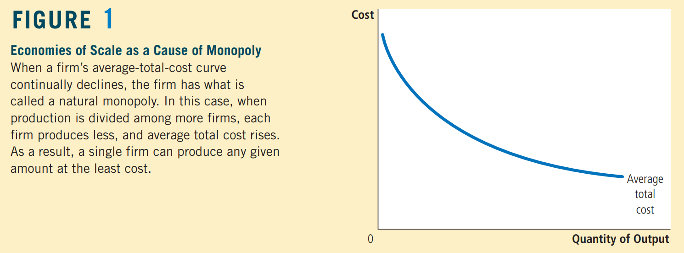
Figure 1 shows the average total costs of a firm with economies of scale. In this case, a single firm can produce any amount of output at the least cost. That is, for any given amount of output, a larger number of firms leads to less output per firm and higher average total cost.

Slide 10
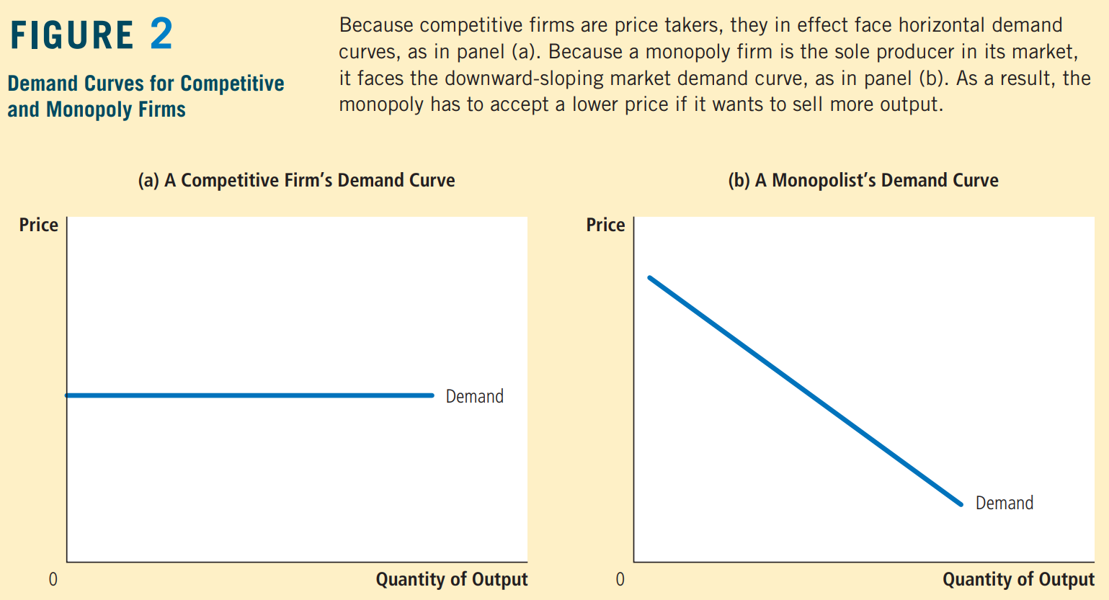
How Monopolies Make Production and Pricing Decisions..?
Monopoly versus Competition

Slide 11
The key difference between a competitive firm and a monopoly is the monopoly’s ability to influence the price of its output.
A monopoly is the sole producer in its market, it can alter the price of its good by adjusting the quantity it supplies to the market.
For competitive firm, the market price is a horizontal line. The competitive firm sells a product with many perfect substitutes (the products of all the other firms in its market), the demand curve that any one firm faces is perfectly elastic.
By contrast, because a monopoly is the sole producer in its market, its demand curve is the market demand curve. Thus, the monopolist’s demand curve slopes downward.
If the monopolist raises the price of its good, consumers buy less of it.
if the monopolist reduces the quantity of output it produces and sells, the price of its output increases.
The market demand curve provides a constraint on a monopoly’s ability to profit from its market power. A monopolist would prefer, if it were possible, to charge a high price and sell a large quantity at that high price. The market demand curve makes that outcome impossible.
By adjusting the quantity produced (or equivalently, the price charged), the monopolist can choose any point on the demand curve, but it cannot choose a point off the demand curve.

Slide 12
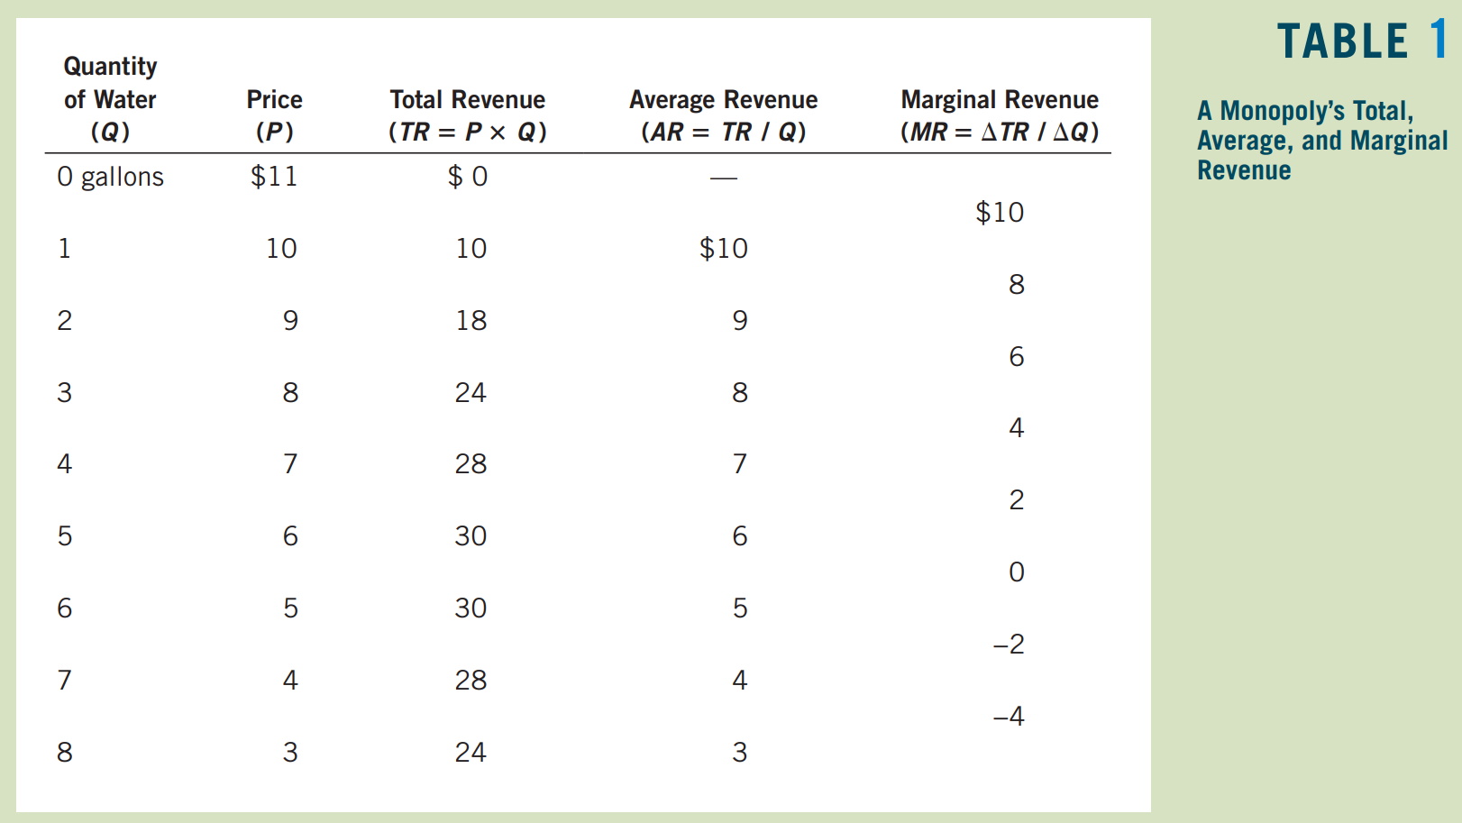
A Monopoly’s Revenue
Consider a town with a single producer of water. Table 1 shows how the monopoly’s revenue might depend on the amount of water produced.

Slide 13
Average revenue always equals the price of the good. This is true for monopolists as well as for competitive firms.
Table 1 shows a result that is important for understanding monopoly behaviour: A monopolist’s marginal revenue is always less than the price of its good.
For example, if the firm raises production of water from 3 to 4 gallons, it will increase total revenue by only $4, even though it will be able to sell each gallon for $7.
For a monopoly, marginal revenue is lower than price because a monopoly faces a downward-sloping demand curve. To increase the amount sold, a monopoly firm must lower the price it charges to all customers.
Marginal revenue for monopolies is very different from marginal revenue for competitive firms.
When a monopoly increases the amount it sells, this action has two effects on total revenue (P × Q):
- The output effect: More output is sold, so Q is higher, which tends to increase total revenue.
- The price effect: The price falls, so P is lower, which tends to decrease total revenue.
Notes:
Because a competitive firm can sell all it wants at the market price, there is no price effect. When it increases production by 1 unit, it receives the market price for that unit, and it does not receive any less for the units it was already selling. That is, because the competitive firm is a price taker, its marginal revenue equals the price of its good. By contrast, when a monopoly increases production by 1 unit, it must reduce the price it charges for every unit it sells, and this cut in price reduces revenue on the units it was already selling. As a result, a monopoly’s marginal revenue is less than its price.

Slide 14
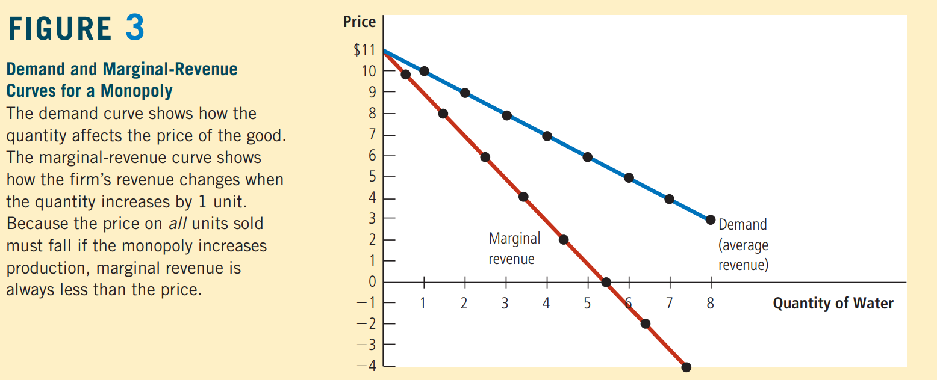
A monopoly’s marginal-revenue curve lies below its demand curve.
Notes:
Figure 3 graphs the demand curve and the marginal-revenue curve for a monopoly firm. (Because the firm’s price equals its average revenue, the demand curve is also the average-revenue curve.) These two curves always start at the same point on the vertical axis because the marginal revenue of the first unit sold equals the price of the good. But for the reason we just discussed, the monopolist’s marginal revenue on all units after the first is less than the price of the good. Thus, a monopoly’s marginal-revenue curve lies below its demand curve.
Marginal revenue can even become negative. Marginal revenue is negative when the price effect on revenue is greater than the output effect. In this case, when the firm produces an extra unit of output, the price falls by enough to cause the firm’s total revenue to decline, even though the firm is selling more units.

Slide 15
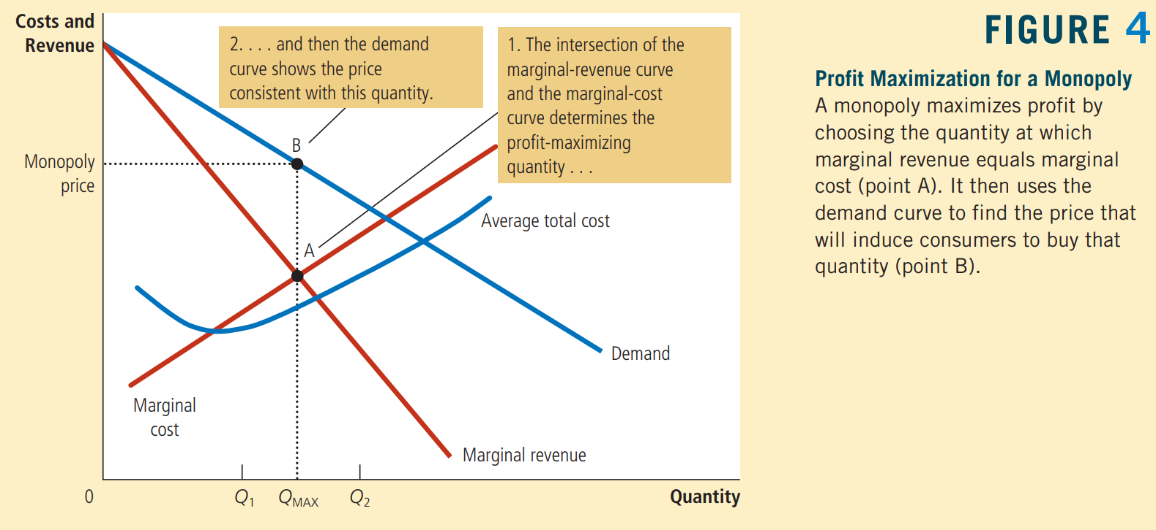
Profit Maximization
We apply the logic of marginal analysis to the monopolist’s decision about how much to produce.
Figure 4 graphs the demand curve, the marginal-revenue curve, and the cost curves for a monopoly firm.
Notes:
When marginal cost is less than marginal revenue, such as at Q1, the firm can increase profit by producing more units.
If marginal cost is greater than marginal revenue, such as Q2, the firm can raise profit by reducing production.
In the end, the firm adjusts its level of production until the quantity reaches QMAX, at which marginal revenue equals marginal cost.

Slide 16
The monopolist’s profit-maximizing quantity of output is determined by the intersection of the marginal revenue curve and the marginal-cost curve. In Figure 4, this intersection occurs at point A.
An important difference between competitive firms and monopolies:
For a competitive firm: P = MR = MC.
For a monopoly firm: P > MR = MC.
The equality of marginal revenue and marginal cost determines the profit-maximizing quantity for both types of firm. What differs is how the price is related to marginal revenue and marginal cost.
How does the monopoly find the profit-maximizing price for its product?
The demand curve answers this question because the demand curve relates the amount that customers are willing to pay to the quantity sold. Thus, after the monopoly firm chooses the quantity of output that equates marginal revenue and marginal cost, it uses the demand curve to find the highest price it can charge for that quantity. In Figure 4, the profit-maximizing price is found at point B.
In competitive markets, price equals marginal cost.
In monopolized markets, price exceeds marginal cost.

Slide 17
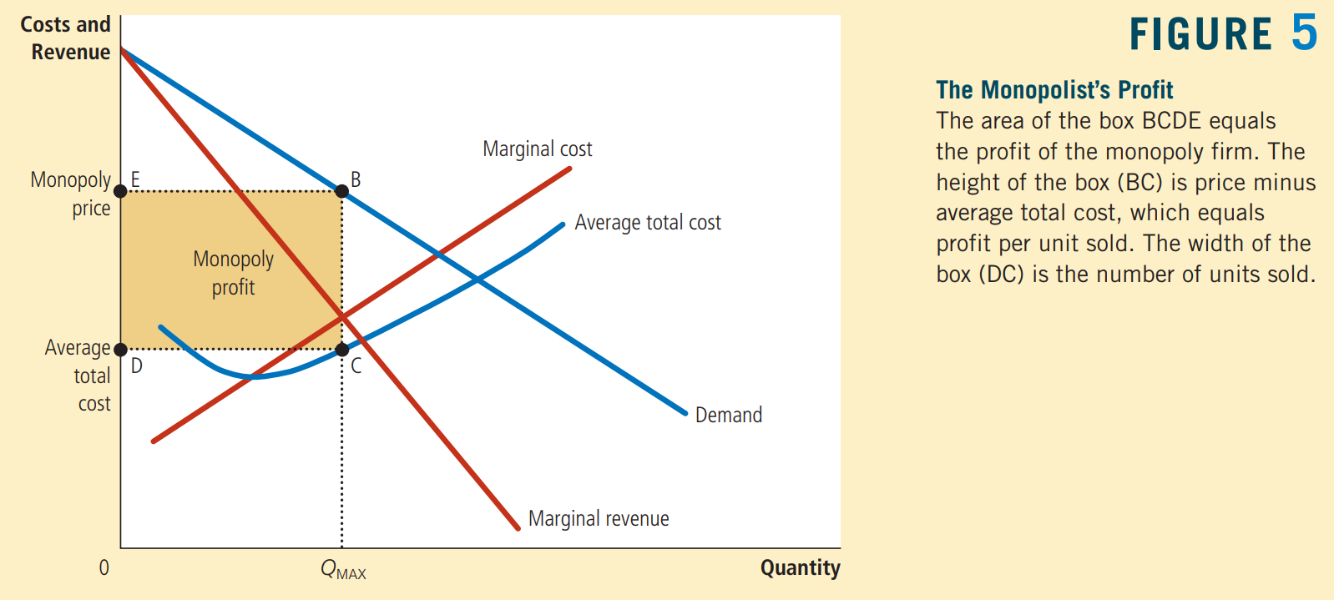
A Monopoly’s Profit
Notes:
Profit = TR − TC.
We can rewrite this as Profit = (TR/Q − TC/Q) × Q.
TR/Q is average revenue, which equals the price, P, and TC/Q is average total cost, ATC.
Therefore, Profit = (P − ATC) × Q.
This equation for profit (which also holds for competitive firms) allows us to measure the monopolist’s profit in our graph.

Slide 18
Case Study: Monopoly Drugs versus Generic Drugs
According to our analysis, prices are determined differently in monopolized markets and competitive markets. A natural place to test this theory is the market for pharmaceutical drugs because this market takes on both market structures. When a firm discovers a new drug, patent laws give the firm a monopoly on the sale of that drug. But eventually, the firm’s patent runs out, and any company can make and sell the drug. At that time, the market switches from being monopolistic to being competitive.
During the life of the patent, the monopoly firm maximizes profit by producing the quantity at which marginal revenue equals marginal cost and charging a price well above marginal cost. But when the patent runs out, the profit from making the drug should encourage new firms to enter the market. As the market becomes more competitive, the price should fall to equal marginal cost.

Slide 19
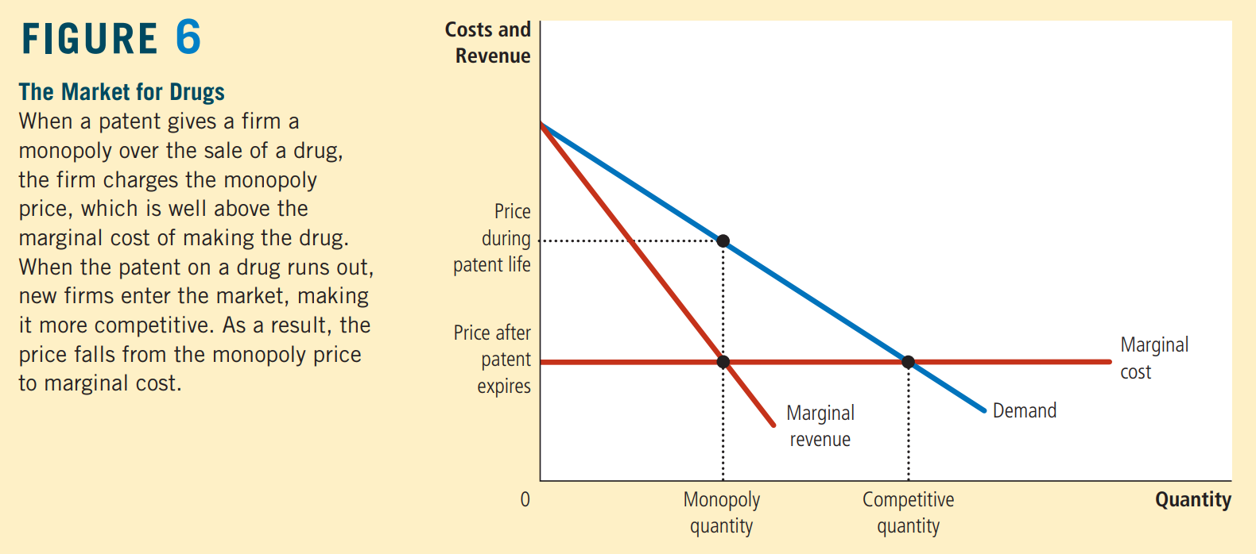

Slide 20
The Welfare Cost of Monopolies
A monopoly, in contrast to a competitive firm, charges a price above marginal cost. From the standpoint of consumers, this high price makes monopoly undesirable.
However, the monopoly is earning profit from charging this high price. From the standpoint of the owners of the firm, the high price makes monopoly very desirable.
Total Surplus measures the economic well-being of buyers and sellers in a market. Total surplus is the sum of consumer surplus and producer surplus. Consumer surplus is consumers’ willingness to pay for a good minus the amount they actually pay for it. Producer surplus is the amount producers receive for a good minus their costs of producing it.
The invisible hand of the market leads to an allocation of resources that makes total surplus as large as it can be.
Because a monopoly leads to an allocation of resources different from that in a competitive market, the outcome must, in some way, fail to maximize total economic well-being.
The monopolist chooses to produce and sell the quantity of output at which the marginal-revenue and marginal-cost curves intersect; the benevolent social planner would choose the quantity at which the demand and marginal-cost curves intersect. Figure 7 & 8 shows the comparison.

Slide 21
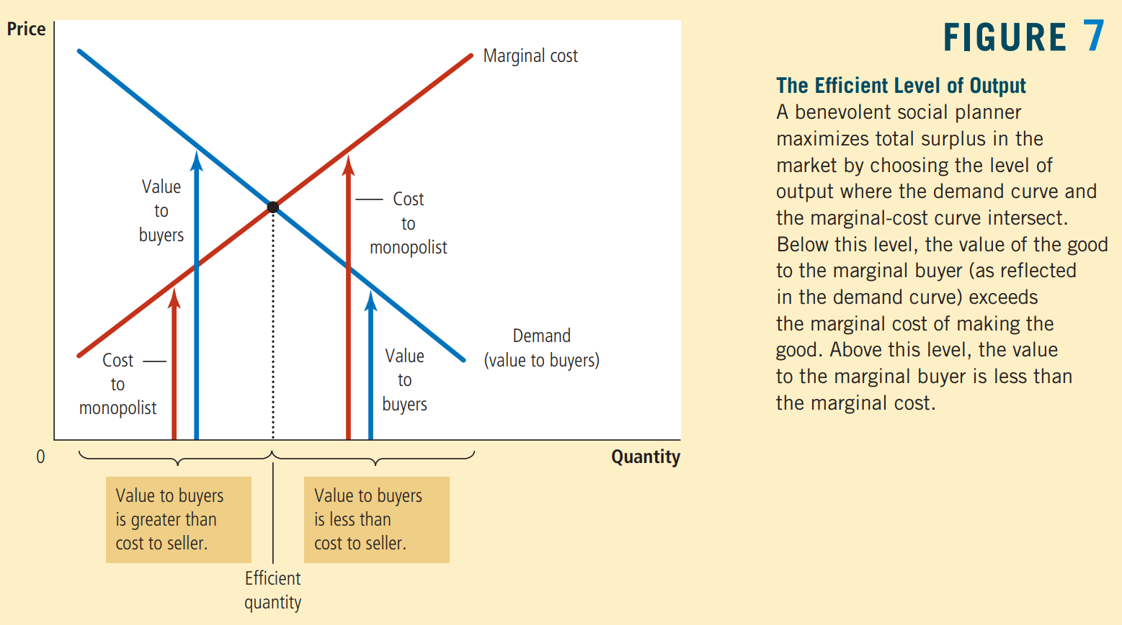
Notes:
Figure 7 analyses how a benevolent social planner would choose the monopoly’s level of output. The demand curve reflects the value of the good to consumers, as measured by their willingness to pay for it. The marginal-cost curve reflects the costs of the monopolist. Thus, the socially efficient quantity is found where the demand curve and the marginal-cost curve intersect.
Below this quantity, the value of an extra unit to consumers exceeds the cost of providing it, so increasing output would raise total surplus. Above this quantity, the cost of producing an extra unit exceeds the value of that unit to consumers, so decreasing output would raise total surplus. At the optimal quantity, the value of an extra unit to consumers exactly equals the marginal cost of production.

Slide 22
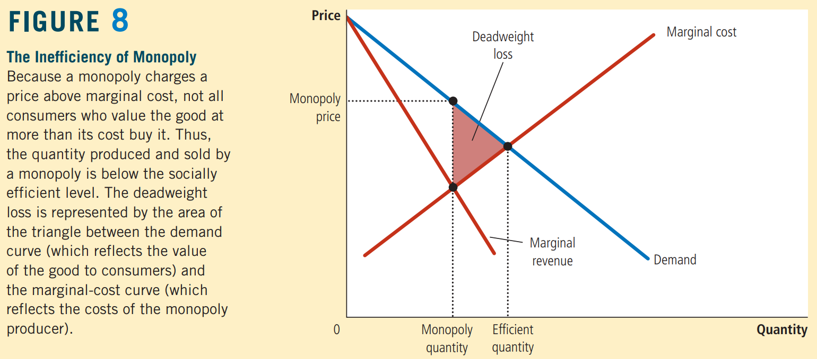
The monopolist produces less than the socially efficient quantity of output.
Notes:
We can also view the inefficiency of monopoly in terms of the monopolist’s price.
Because the market demand curve describes a negative relationship between the price and quantity of the good, a quantity that is inefficiently low is equivalent to a price that is inefficiently high. When a monopolist charges a price above marginal cost, some potential consumers value the good at more than its marginal cost but less than the monopolist’s price. These consumers do not buy the good. Because the value these consumers place on the good is greater than the cost of providing it to them, this result is inefficient. Thus, monopoly pricing prevents some mutually beneficial trades from taking place.

Slide 23
Deadweight Loss
The inefficiency of monopoly can be measured with a deadweight loss triangle, as illustrated in Figure 8.
Because the demand curve reflects the value to consumers and the marginal-cost curve reflects the costs to the monopoly producer, the area of the deadweight loss triangle between the demand curve and the marginal-cost curve equals the total surplus lost because of monopoly pricing.
It is the reduction in economic well-being that results from the monopoly’s use of its market power.
The problem in a monopolized market arises because the firm produces and sells a quantity of output below the level that maximizes total surplus.
The deadweight loss measures how much the economic pie shrinks as a result.
This inefficiency is connected to the monopoly’s high price: Consumers buy fewer units when the firm raises its price above marginal cost.
Thus, monopoly pricing prevents some mutually beneficial trades from taking place, this result is inefficient.

Slide 24
Price Discrimination
price discrimination - the business practice of selling the same good at different prices to different customers
Many a times, a monopoly firm sells the same good to different customers for different prices, even though the costs of producing for the two customers are the same. This practice is called price discrimination.
Price discrimination is not possible when a good is sold in a competitive market. In a competitive market, many firms are selling the same good at the market price. For a firm to price discriminate, it must have some market power.
Three Lessons On The Behaviour Of A Price-discriminating Monopolist:
Price discrimination is a rational strategy for a profit-maximizing monopolist. That is, by charging different prices to different customers, a monopolist can increase its profit. In essence, a price discriminating monopolist charges each customer a price closer to her willingness to pay than is possible with a single price.
Price discrimination requires the ability to separate customers according to their willingness to pay. For example, customers can be separated geographically (Academic Text Book prices in US is far higher than in India). But sometimes monopolists choose other differences, such as age or income, to distinguish among customers.
Price discrimination can raise economic welfare by helping in avoiding dead-weight loss. Thus, price discrimination can eliminate the inefficiency inherent in monopoly pricing.

Slide 25
Analysing Price Discrimination
1) Perfect Price Discrimination
Perfect price discrimination describes a situation in which the monopolist knows exactly each customer’s willingness to pay and can charge each customer a different price. In this case, the monopolist charges each customer exactly her willingness to pay, and the monopolist gets the entire surplus in every transaction.
Figure 9 illustrates producer and consumer surplus with and without price discrimination.
2) Imperfect price discrimination
In reality, of course, price discrimination is not perfect. Customers do not walk into stores with signs displaying their willingness to pay. Instead, firms price discriminate by dividing customers into groups: young versus old, weekday versus weekend shoppers, Americans versus Australians, and so on. Customers within each group differ in their willingness to pay for the product, making perfect price discrimination impossible.
Compared to the monopoly outcome with a single price, imperfect price discrimination can raise, lower, or leave unchanged total surplus in a market. The only certain conclusion is that price discrimination raises the monopoly’s profit; otherwise, the firm would choose to charge all customers the same price.

Slide 26
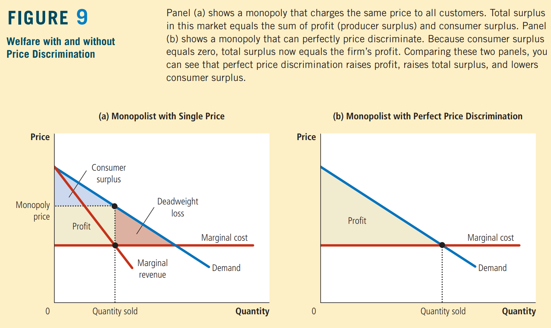

Slide 27
Examples of Price Discrimination
Firms in our economy use various business strategies aimed at charging different prices to different customers. Some examples:
Airline Prices: Seats on airplanes are sold at many different prices. Most airlines charge a lower price for a round-trip ticket between two cities if the traveller stays over a Saturday night. The reason is that this rule provides a way to separate business travellers and leisure travellers.
Discount Coupons: Many companies offer discount coupons to the public in newspapers, magazines, or online. A buyer simply has to clip the coupon to get some off on her next purchase. Why do companies offer these coupons? Why don’t they just cut the price of the product? (see the notes section below)
Financial Aid: Many colleges and universities give financial aid to needy students. One can view this policy as a type of price discrimination.
Quantity Discounts Sometimes, monopolists price discriminate by charging different prices to the same customer for different units that the customer buys. For example, many firms offer lower prices to customers who buy large quantities.
Quantity discounts are often a successful way of price discriminating because a customer’s willingness to pay for an additional unit declines as the customer buys more units.
Notes:
Airline Prices: A passenger on a business trip has a high willingness to pay and, most likely, does not want to stay over a Saturday night. By contrast, a passenger traveling for personal reasons has a lower willingness to pay and is more likely to be willing to stay over a Saturday night. Thus, the airlines can successfully price discriminate by charging a lower price for passengers who stay over a Saturday night.
Discount Coupons: The answer is that coupons allow companies to price discriminate. Companies know that not all customers are willing to spend time clipping coupons. Moreover, the willingness to clip coupons is related to the customer’s willingness to pay for the good. A rich and busy executive is unlikely to spend her time clipping discount coupons out of the newspaper, and she is probably willing to pay a higher price for many goods. A person who is unemployed is more likely to clip coupons and to have a lower willingness to pay. Thus, by charging a lower price only to those customers who clip coupons, firms can successfully price discriminate.
Financial Aid: Wealthy students have greater financial resources and, therefore, a higher willingness to pay than needy students. By charging high tuition and selectively offering financial aid, schools in effect charge prices to customers based on the value they place on going to that school. This behaviour is similar to that of any price-discriminating monopolist.
Quantity Discounts: A bakery might charge $0.50 for each donut but $5 for a dozen. This is a form of price discrimination because the customer pays a higher price for the first unit bought than for the twelfth.
Quantity discounts are often a successful way of price discriminating because a customer’s willingness to pay for an additional unit declines as the customer buys more units.

Slide 28
Public Policy toward Monopolies
Monopolies produce less than the socially desirable quantity of output and charge prices above marginal cost. Policymakers in the government can respond to the problem of monopoly in one of four ways:
By trying to make monopolized industries more competitive (Antitrust Laws)
By regulating the behavior of the monopolies (price regulation of water, electricity)
By turning some private monopolies into public enterprises.
By doing nothing at all.
Notes:
Increasing Competition with Antitrust Laws
The antitrust laws give the government various ways to promote competition. They allow the government to prevent mergers, such as a hypothetical merger between Coca-Cola and PepsiCo. They also allow the government to break up companies. For example, in 1984, the US government split up AT&T, the large tele-communications company, into eight smaller companies. Finally, the antitrust laws prevent companies from coordinating their activities in ways that make markets less competitive.
Antitrust laws have costs as well as benefits. Sometimes companies merge not to reduce competition but to lower costs through more efficient joint production. These benefits from mergers are sometimes called synergies. For example, many Indian banks have merged in recent years and, by combining operations, have been able to reduce administrative staff.
Regulation
Another way the government deals with the problem of monopoly is by regulating the behaviour of monopolists. This solution is common in the case of natural monopolies, such as water and electric companies. These companies are not allowed to charge any price they want. Instead, government agencies regulate their prices.
Public Ownership
The third policy used by the government to deal with monopoly is public ownership. That is, rather than regulating a natural monopoly that is run by a private firm, the government can run the monopoly itself. This solution is common in many countries, where the government owns and operates utilities such as telephone, water, and electric companies, postal service, railways, etc.
By doing nothing at all: if the market failure is deemed small compared to the inevitable imperfections of policies, governments can decide to do nothing at all.

Slide 29
Features of Monopoly
Single Seller – The monopolist is the only producer of the good. So, the distinction between firm and industry disappears. There is only one seller or producer of commodity.
No Close Substitute – There are no close substitute for the commodity produced by the monopolist. The monopolist produces all the output in a particular market, thus he is a price maker.
Barriers to Entry – There are significant barriers to entry. It is characterised by closed entry to the prospective producers.
Perfect Knowledge – Monopolist is assumed to be having perfect knowledge about the market conditions.

Slide 30
TYPES OF MONOPOLY
Pure Monopoly : When a single seller produces such a product which has neither a near nor a remote substitute and the seller takes the whole of the country income all the time, it is called pure monopolist.
Simple Monopoly : Under this type of market structure, the monopolist cannot set a price to maximize his industry profit without attracting entry of new firms. But he may set a lower price at which entry will not be attracted.
Discriminating Monopoly: This is a market structure where the monopolist charges different prices from different consumers for the same good or services at the same time.

Slide 31
Natural Monopolies
Some industries are characterized by conditions that create barriers to entry
Location
Economies of scale
Utilities are the classic example:
Water
Electricity
Rail transport
Defense

Slide 32
Protected Monopolies
Barriers to entry in some industries are the result of specific protections granted by government
Licenses
Patents
Examples:
Concessions in national park
Pharmaceuticals – patents
Copyright

Slide 33
The Degree of Monopoly Power
By monopoly power we mean the amount of discretion which a producer and seller possesses in regard to the framing of his price and output policy. There are mainly three measures of monopoly power which are as follows :
Elasticity of Demand as a Measure of Monopoly Power: A precise measure of monopoly power is given by the inverse of the elasticity of demand. Thus,
Degree of monopoly power = 1 / ep
Where ep is the absolute value of price elasticity of demand.
The less the elasticity of demand, the greater the monopoly power and the greater the elasticity of demand, the less the degree of monopoly power.

Slide 34
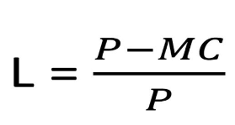
2) Lerner’s Index of Monopoly Power
Economist Lerner has given the following precise index of monopoly power.
LERNER INDEX = (PRICE - MARGINAL COST) / PRICE
When competition is pure or perfect, price(P) is equal to marginal cost and therefore Lerner’s index of monopoly power is equal to zero indicating no monopoly power at all.
When MC is zero, L will be equal to unity . Thus, Lerner’s index of monopoly power can vary from zero to unity.

Slide 35
3) Cross Elasticity of Demand as a Measure of Monopoly Power
The cross elasticity of demand points to the degree of dependence of a firm’s products. The smaller the extent of cross elasticity of demand for the product of a firm, the greater the degree of monopoly power enjoyed by it and vice-versa.

Slide 36
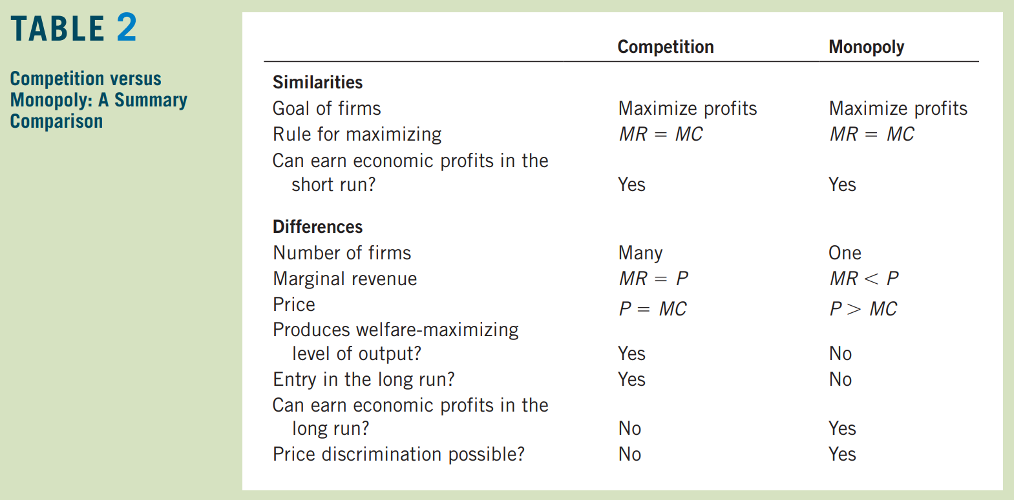
Conclusion:
We have discussed the behaviour of firms that have control over the prices they charge. We have seen that these firms behave very differently from the competitive firms. Table 2 summarizes some of the key similarities and differences between competitive and monopoly markets.
From the standpoint of public policy, a crucial result is that a monopolist produces less than the socially efficient quantity and charges a price above marginal cost. As a result, a monopoly causes deadweight losses. In some cases, these inefficiencies can be mitigated through price discrimination by the monopolist, but other times, they call for policymakers to take an active role.

